Slide 1
System Development Methods CT00046-3-2
Process Oriented Methodologies

Slide 2
Topic & Structure of the Lesson
Principles of the process-oriented methodologies.
Rapid Application Development (RAD)
Rational Unified Process (RUP)
SCRUM
Extreme Programming (XP)
Spiral Methods
The strengths and weaknesses of the process-oriented methodologies

Slide 3
Learning Outcomes
By the end of this lecture, you should be able to :
Identify and explain the underlying principles of the process-oriented methodologies.
Describe the phases in the process-oriented methodologies
Describe the strengths and weaknesses of the process-oriented methodologies

Slide 4
Key Terms you must be able to use
If you have mastered this topic, you should be able to use the following terms correctly in your assignments and exams:
Process Oriented Methodologies
Rapid Application Development (RAD)
Rational Unified Process (RUP)
SCRUM
Extreme Programming (XP)
Spiral Methods

Slide 5
Process Oriented Methodologies Principles

Slide 6
Process Oriented Methodologies
The proposed methodology can be applied to complex and distributed business processes.
The business process is converted into functions in a system.
Steps of Methods:
Business process is studied
Processes and tasks are broken down into smallest workable components.
Each sub-process can be assigned a time, cost and resources for it to complete.
This can be shown in planning charts such as Gantt Chart, PERT Chart, Task Breakdown Structure, etc.

Slide 7
Rapid Application Development (RAD)

Slide 8
Rapid Application Development (RAD)
‘Fast’ methodology for fast / urgent projects
Within days / weeks
Rapid application development (RAD) is a team-based technique that speeds up information systems development and produces a functioning information system.
Companies use RAD to reduce cost and development time and increase the probability of success.

Slide 9
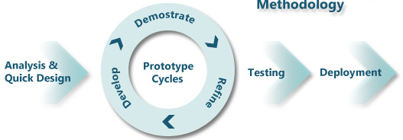
Rapid Application Development (RAD) Phases
The four phases of the RAD model are requirements analysis and quick design, prototype cycles, testing, and deployment.

Slide 10
Rapid Application Development (RAD) Phases (continued)
Analysis and Design
Users, managers, and IT staff members discuss and agree on business needs, project scope, constraints, and system requirements. The requirements planning phase ends when the team agrees on the key issues and obtains management authorization to continue.
During the design, users interact with systems analysts and develop models and prototypes that represent all system processes, outputs, and inputs. The RAD group or subgroups typically use a combination of JAD techniques and CASE tools to translate user needs into working models.
Joint application development (JAD) is a technique that brings users into the development process as active participants.

Slide 11
Rapid Application Development (RAD) Phases (continued)
Prototypes Cycles
Develop
Focuses on program and application development tasks. Users continue to participate and still can suggest changes or improvements as actual screens, or reports are developed.
Development is a continuous, interactive process that allows users to understand, modify, and eventually approve a working model of the system that meets their needs.
Demonstrate and Refine
Developers demonstrate the progress and gather feedback from users to improve prototypes and create the best possible product.

Slide 12
Rapid Application Development (RAD) Phases (continued)
Test
This step requires developers to test the software product and ensure that all parts work together as per client’s expectations.
Continue incorporating client feedback as the code is tested and retested for its smooth functioning.
Deployment
This phase resembles the final tasks in the SDLC implementation phase, including data conversion, user acceptance testing, changeover to the new system, and user training.
Compared with traditional methods, the entire process is compressed. As a result, the new system is built, delivered, and placed in operation much sooner.

Slide 13

Rapid Application Development (RAD) Techniques
Expert developers used.
Uses tools (CASE Tools) for faster development and testing.
CASE tools are powerful software used in computer-aided systems engineering to help systems analysts develop and maintain information systems e.g., construction tools, data dictionaries and, documentation tools.
Uses minimal planning, analysis and documentation
Uses Prototype for user feedback and review
Users are involved in development

Slide 14
Rapid Application Development (RAD) Techniques (continued)
Iterative and Incremental design approach with prototyping
A system is developed through repeated cycles and in smaller portions at a time.
Build a series of prototypes and constantly adjusting them to user requirements.
Allows developers to take advantage of what was learned during the development of earlier parts or versions of the system.

Slide 15
Rapid Application Development (RAD) Advantages and Disadvantages
Advantages
Systems can be developed more quickly with significant cost savings.
Cut development time and expense by involving users in every phase of systems development.
Because it is a continuous process, RAD allows the development team to make necessary modifications quickly, as the design evolves.
Disadvantages
RAD stresses the mechanics of the system itself and does not emphasize the company’s strategic business needs.
The risk is that a system might work well in the short term, but the corporate and long-term objectives for the system might not be met.
The accelerated time cycle might allow less time to develop quality, consistency, and design standards.

Slide 16
Rational Unified Process (RUP)

Slide 17
Rational Unified Process (RUP)
Originally developed by Booch, Rumbaugh, and Jacobson, who previously developed UML at Rational Software (now part of IBM).
The RUP is now widely recognized as a highly influential innovation in software development methodologies for object-oriented development using an adaptive approach.
The original version of RUP defined an elaborate set of activities and deliverables for every step of the development process.
More recent versions are streamlined, with fewer activities and deliverables, simplifying the methodology.
Much of the book’s methodology is loosely based on the Unified Process (in an agile form).

Slide 18
Rational Unified Process (RUP) (continued)
“plan a little, design a little, and code a little”
Very careful development method, emphasis on quality of product and process.
Extensive and exclusive use of UML, and direct support for Object-Oriented Programming.
Takes a holistic approach of the system:
Architecture of the system determined
Tasks are broken-down into smaller components.
Iterative & incremental approach applied to do all tasks.

Slide 19
Rational Unified Process (RUP) Life Cycle
The RUP Process Life Cycle model includes iterations and phases.
Each RUP phase is made up of iterations. The phases are Inception, Elaboration, Construction, and Transition.

Slide 20
Rational Unified Process (RUP) Life Cycle (continued)
Inception Phase: the basic idea and structure of the project are determined.
Elaboration Phase: to analyze the requirements and necessary architecture of the system
Construction Phase: when the coding and implementation will take place.
Transition Phase: when the finished product is finally released and delivered to customers, also handle all post-release support, bug fixes, patches, and so forth.

Slide 21
Rational Unified Process (RUP) Disciplines
RUP Disciplines – a set of functionally related activities that combine to enable the development process in a UP project (each like a core development process):
Business modeling
Requirements
Design
Implementation
Testing
Deployment
Configuration and change management
Project management
Environment

Slide 22
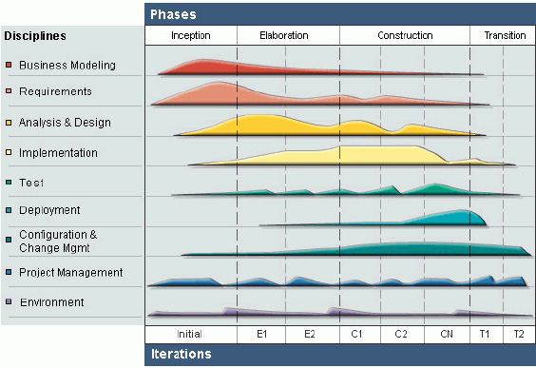
Rational Unified Process (RUP) Phases

Slide 23
Rational Unified Process (RUP) Phases (continued)
All aspects of the RUP are based on a set of building blocks, which are used to describe:
‘Who’ – Project member: an individual, or a group of individuals together as a team, working on any activity in order to produce artifacts.
‘What’ - Artifacts: An artifact represents any tangible output from the process e.g., design specification.
‘How’ - Activities: A unit of work that a project member is to perform. Activities should have a clear purpose, typically by creating or updating artifacts.
‘When’ - Workflows: Represents a sequence of activities, in order to produce artifacts.

Slide 24
Rational Unified Process (RUP) Phases (continued)
Business Modeling:
the business context (scope) of the project should be outlined.
Requirements
to define all potential requirements of the project, throughout the software development life cycle.
Analysis & Design - transforms requirements into a design that can be properly implemented.
Implementation
where most actual coding takes place, implementing and organizing all the code that make up the whole of the system.
Test - perform various Testing
Deployment
constitutes the entire delivery and release process, to ensure that the system meets customer’s expectations.

Slide 25
Rational Unified Process (RUP) Phases (continued)
Configuration & Change Management Workflow:
Describe the various artifacts produced by the development team.
Make sure that there is minimal overlap or wasted efforts performing similar activities that result in identical or conflicting artifacts.
Project Management :
Where all activities dealing with project management, from pushing design objectives, risk management, overcoming delivery constraints.
Environment :
Handles the setup and management of all software development cycle, including the processes, tools, and team members

Slide 26
Rational Unified Process (RUP) Practices
Focuses early and often on users
Use case driven
Model driven – uses UML exclusively
Iterative, but provides management structure by defining phases
Focuses on defining an architecture
Adaptable to the needs of a specific project
Can be made highly agile, but originally had heavy ceremony

Slide 27
SCRUM

Slide 28
Scrum
Another influential agile, iterative development methodology based on ideas from Rugby.
A ‘team-work’ based methodology.
A Scrum begins quickly, is a very intense effort, involves the entire team, and usually only lasts for a short duration
Scrum philosophy is the complete control a team exerts over its own organization and its work processes. Software is developed incrementally, and controls are imposed empirically—by focusing on things that can be accomplished.

Slide 29
Scrum Organization
User Stories/Inputs – developer & user determine general concepts.
Product backlog – a prioritized list of user requirements used to choose work to be done in a Scrum project
Only a few of the high-priority items are worked on at a time
Sprint Backlog is a subset of items from the product backlog that have been selected to be part of a Sprint.
Product owner – the client stakeholder for whom the system is being built, responsible for business requirements, project backlog and priorities.
Scrum master – the person in charge of a Scrum project—similar to a project manager, helps to solve the ‘gaps’ in the project such as solving problems or giving ideas.
Scrum team is usually 5 to 9 people, from mixed skills.
Scrum team sets own goals, organizes self, makes decisions

Slide 30
Scrum Practices
Sprint – a time-controlled mini-project that implements a specific portion of a system
Firm 30-day time box with a specific goal or deliverable
The scope of that sprint is then frozen, and no one can change it—neither the product owner nor any other users
Sprint backlog defines the scope
Daily Scrum – a daily meeting of all members of the team to report progress (15 minutes max)
Sprint final half-day review meeting – scheduled to review and identify changes needed for the following sprints

Slide 31
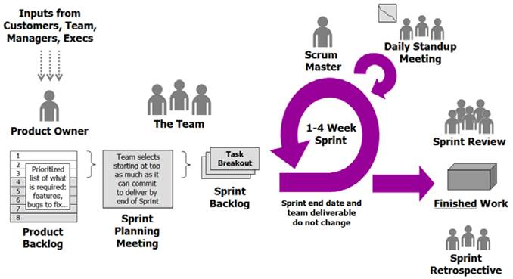
Scrum Methodology

Slide 32

Scrum Methodology SCRUM ceremonies that must take place.
Sprint Planning: This is where the team meets and decides what they need to complete in the coming sprint
This ceremony helps to set up the entire team for the coming sprint, creating a smooth pathway for a successful sprint.
Sprint planning requires the participation of all the scrum roles: the development team, scrum master and the product owner.
The planning, of course, is prior to the sprint. It typically lasts for an hour or two.

Slide 33
Scrum Methodology SCRUM ceremonies that must take place (continued)
Daily Scrum: This is a standup meeting or a very short – 15-minute mini-meeting – for the team to make sure they’re all on the same page.
It’s a way to ensure transparency across the team.
Daily scrum demands accountability
Sprint Review: This is another type of meeting, but one in which the team demos what they shipped in the sprint.
Demonstrates the finished work for the entire team, so they can provide feedback and get feedback
from the stakeholders in the project.

Slide 34
Scrum Methodology SCRUM ceremonies that must take place (continued)
Sprint Retrospective: This is when the team reviews their work, identifying what they did well and what didn’t go as planned, so they can make the next sprint better.
Because scrum is part of an agile process, it is all about change, which includes getting feedback and quickly acting on it.
Scrum seeks continuous improvement, and the retrospective is a method to make sure that the product and development culture is constantly improving.

Slide 35
Extreme Programming (XP)

Slide 36
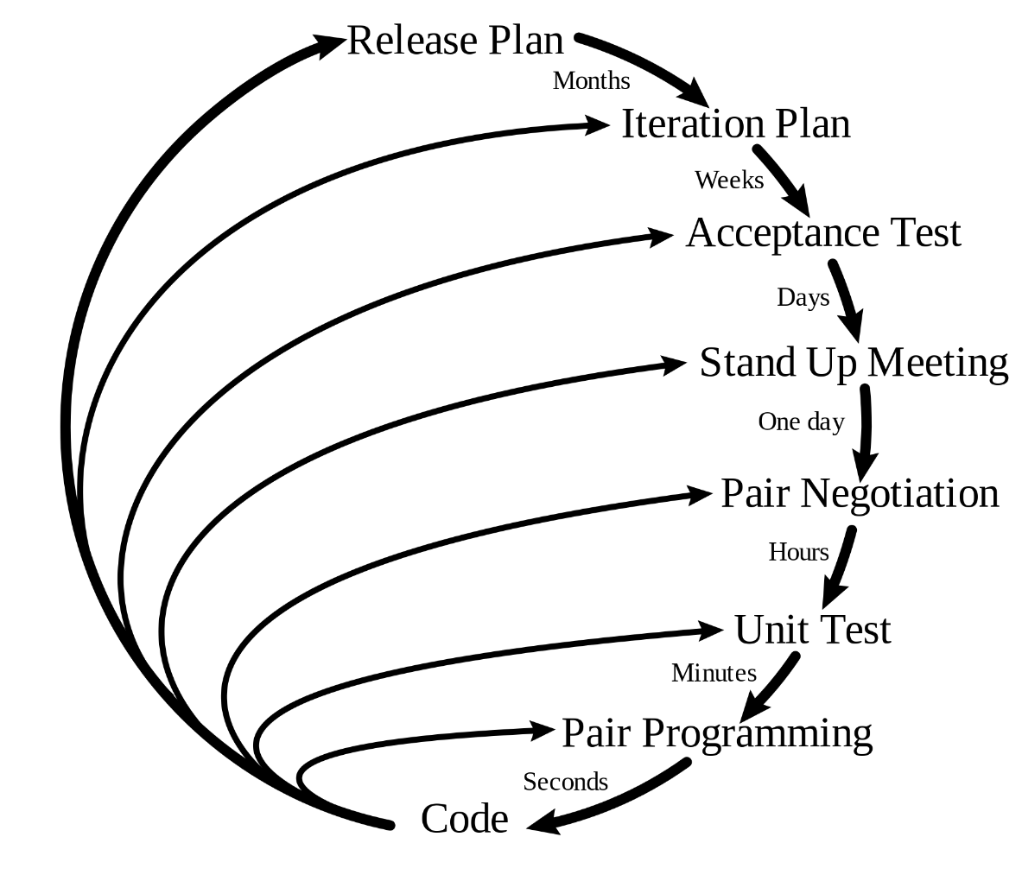
Extreme Programming (XP)
Very flexible methodology.
Effective Programming / coding approach.
For projects involving heavy coding / software building
Uses most of the Agile Principles

Slide 37
Extreme Programming (XP) Core Values
Communication—one of the major causes of project failure is a lack of open communication among the right players at the right time and at the right level
Simplicity—XP includes techniques to reinforce keeping things simple to make it a standard way of developing systems
Feedback—as with simplicity, getting frequent, meaningful feedback is recognized as a best practice of software development
Courage—developers always need courage to face the harsh choice of doing things right or throwing away bad code and starting over

Slide 38
Extreme Programming (XP) Practices
Planning—XP planning focuses on making a rough plan quickly and then refining it as things become clearer. This reflects the Agile development philosophical dictum that change is more important than detailed plans
Testing—XP intensifies testing by requiring that the tests for each use case (story) be written first—before the solution is programmed
Pair Programming—XP practice in which two programmers work together on designing, coding, and testing software
Simple Designs—XP conforms to the principles of Agile Modeling. It accomplishes the desired result with as few classes and methods as possible and that doesn’t duplicate code

Slide 39
Extreme Programming (XP) Practices (continued)
Refactoring the Code— refactoring is the technique of improving the code without changing what it does. XP programmers continually refactor their code to achieve a simpler design
Owning the Code Collectively —in XP, everyone is responsible for the code. Collective ownership allows anyone to modify any piece of code.
Continuous Integration —this practice embodies XP’s idea of “growing” the software. Small pieces of code—which have passed the unit tests—are integrated into the system daily or even more often
On-Site Customer —as with all adaptive approaches, XP projects require continual involvement of users who can make business decisions about functionality and scope

Slide 40
Extreme Programming (XP) Practices (continued)
System Metaphor —a system metaphor should be easily understood and well known to the members of the development team. It can guide members toward a vision and help them understand the system
Small Releases —consistent with the entire philosophy of growing the software, small and frequent releases provide upgraded solutions to the users and keep them involved in the project
Forty-Hour Week — the exact number of hours a developer works are not the issue. The issue is that the project shouldn’t be a death march that burns out every member of the team
Coding Standards —developers should follow standards for coding and documentation

Slide 41
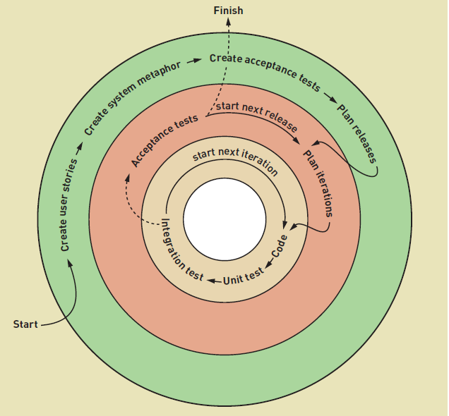
XP Activities: Project Activities Release Activities Iteration Activities

Slide 42
Extreme Programming (XP) Techniques
Small and frequent "releases" in short development cycles
Development team – fully integrated
Pair programming, stand-up meetings
Test driven development
Close user involvement , testing
Accept changing requirement at any time
Simplicity in everything
Tries to simplify all processes
Produce high quality software.

Slide 43

Extreme Programming (XP) Techniques (continued)
Pair Programming
Where two developers work using only one machine.
Each one has a keyboard and a mouse.
One programmer acts as a main driver who codes, while the other will serve as an observer who will check the code being written, proofread and spell check, while also figuring out where to go next.
These roles can be switched at any time.

Slide 44
SPIRAL

Slide 45
Spiral Methods
Spiral models initially were suggested in the 1990s by Barry Boehm, a noted software engineering professor. He stated that each iteration, or phase, of the model must have a specific goal that is accepted, rejected, or changed by the user, or client.
Thus, which enable the team to reach the overall project goal.
Typically, each iteration in a spiral model includes planning, risk analysis, engineering, and evaluation.
“Risk-driven” process model. The next steps to be done is determined based on the ‘Risk’ pattern.
For projects which have high risk:
Unclear / unfixed requirements
Projects have too many independent components
Projects have too many stakeholders which don’t agree with things.

Slide 46
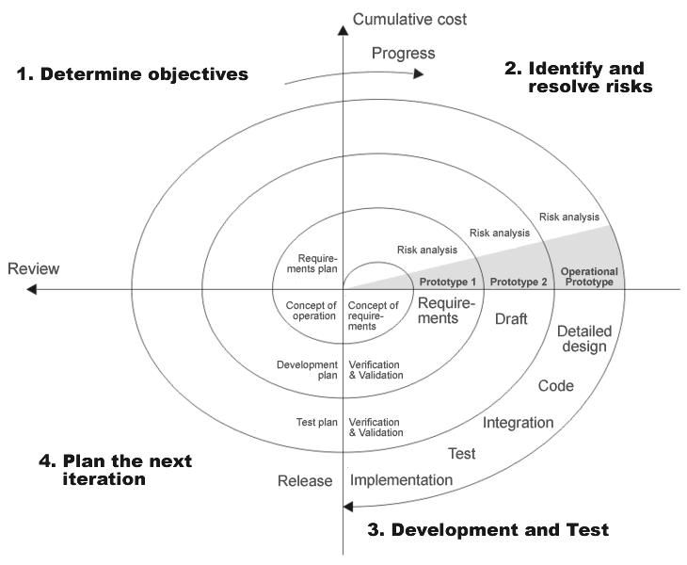
Spiral Methods Phases
Planning
Risk Analysis
Evaluation
Engineering

Slide 47
Spiral Methods Phases (continued)
Planning Phase
Define objectives, constraints, and deliverables
Risk Analysis
Identify risks and develop acceptably resolutions
Engineering Phase
Develop a prototype that includes all deliverables and perform integration.
Various functional testing was carried out.
Evaluation phase
Deploy system at the user’s site and perform assessment and user testing to develop objectives for the next iteration.
Allows users to evaluate the output of the project to date before the project continues to the next spiral.

Slide 48
Watch the following video about the phase in Spiral methods:
Spiral Methods

Slide 49
Strengths and Weaknesses

Slide 50
Strengths In General
Speeds up system development and delivers precisely what the customer wants, when the customer wants it, while fostering teamwork and empowering employees.
Attempt to develop a system incrementally, by building a series of prototypes and constantly adjusting them to user requirements.
Each iteration has a deliverable.
Often, each iteration also integrates a new piece into the growing total system.
Within each iteration, the new pieces are tested by themselves and as integrated with the rest of the system.
The users also get involved in testing the system’s ability to meet their business needs.
Hence, testing and quality control are spread across the entire project and usually provide a better-tested and more robust system.

Slide 51
Weaknesses In General
The project scope isn’t well understood and that there will be many changes, updates, and refinements to the requirements as the project progresses.
Without a detailed set of system requirements, certain features requested by some users might not be consistent with the company’s larger game plan.
Include weak documentation, blurred lines of accountability, and too little emphasis on the larger business picture.
A long series of iterations might add to project cost and development time.
May not work as well for larger projects because of their complexity and the lack of focus on a well-defined product.

Slide 52
Summary
Process-oriented methodologies can be applied to complex and distributed business processes where the business process is converted into functions in a system.
RAD and RUP use iterative and incremental design approaches with prototyping, where a system is developed through repeated cycles and in smaller portions at a time, building a series of prototypes, and constantly adjusting them to user requirements.
SCRUM is a teamwork methodology and has four essential ceremonies include sprint planning, daily meeting, sprint review, and sprint retrospective.
XP releases small and frequent progress with a fully integrated development team to produce high-quality software. It accepts changing requirements at any time, tries to simplify all processes.
The Spiral is suitable for projects which have high risk where unclear requirements, projects that have too many independent components, and too many stakeholders who don’t agree with things.

Slide 53
Question & Answer

Slide 54
Next Session
People Oriented Methodologies

Slide 55
References
Satzinger, J. W., Jackson, R. B., & Burd, S. D. (2015). Systems Analysis and Design in A Changing World. Cengage learning.
Martin, R. C., Newkirk, J., & Koss, R. S. (2003). Agile Software Development: Principles, Patterns, and Practices (Vol. 2). Upper Saddle River, NJ: Prentice Hall.

